Slide 1
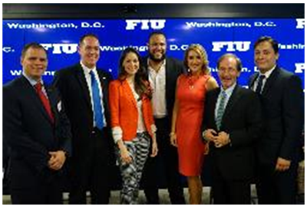
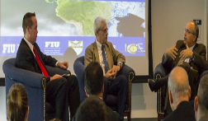
Pre-Law Advising
FIU Pre-Law Advisors
Criminology and Criminal Justice
Amanda Knapp amknapp@fiu.edu
Politics and International Relations
Yomaida Ortiz yortizpo@fiu.edu
No single major prepares you for law school
Pre-Law is not a major; you should select a major that features the following:
Advanced Reading & Writing
Logic Courses
Research
Public Speaking
http://prelaw.fiu.edu/

